Slide 1
Magic The Gathering Deck Suggester
A tool that can suggest cards based on recent tournament data

Slide 2
Why Magic?
What is Magic the Gathering?

Slide 3
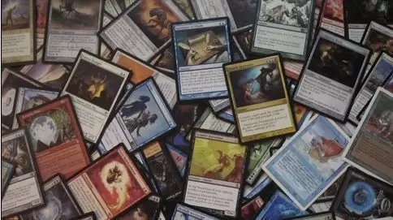
Magic is a game with a massive audience and massive complexity
Magic has over 40 million active players, many of whom compete in tournaments held around the world.
with over 20,000 unique cards, choosing what cards go into your deck can be a difficult undertaking.

Slide 4
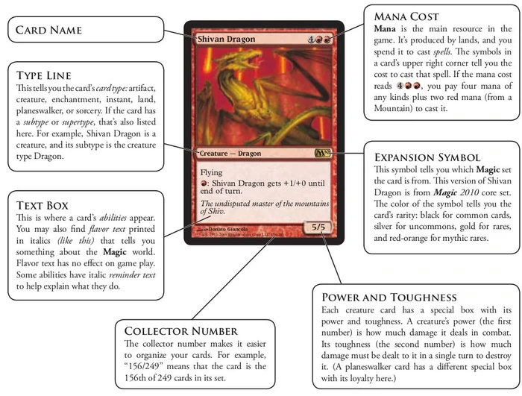
What’s on a card?
Each card has a unique combination of abilities and traits.
For our purposes, we focused on a select few most relevant traits.
Namely, we focused on card names, mana cost, and power and toughness for creatures.
Image source: https://mtg.fandom.com/wiki/Parts_of_a_card

Slide 5
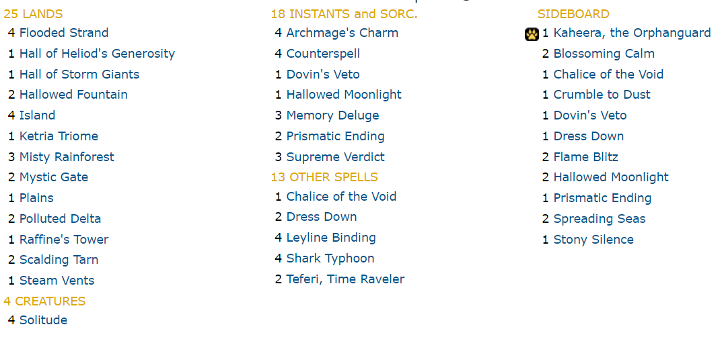
What’s in a deck?
A deck is a collection of at least 75 cards, no more than four of which can share the same name.
Here you can see an exemplar decklist.

Slide 6
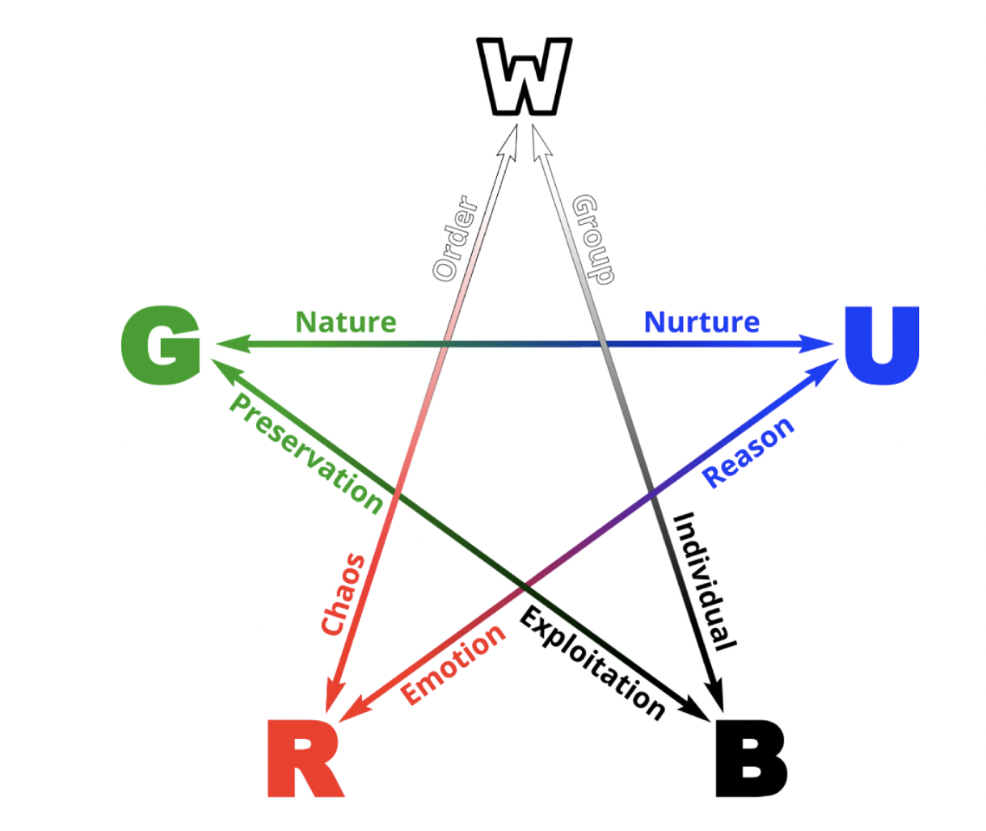
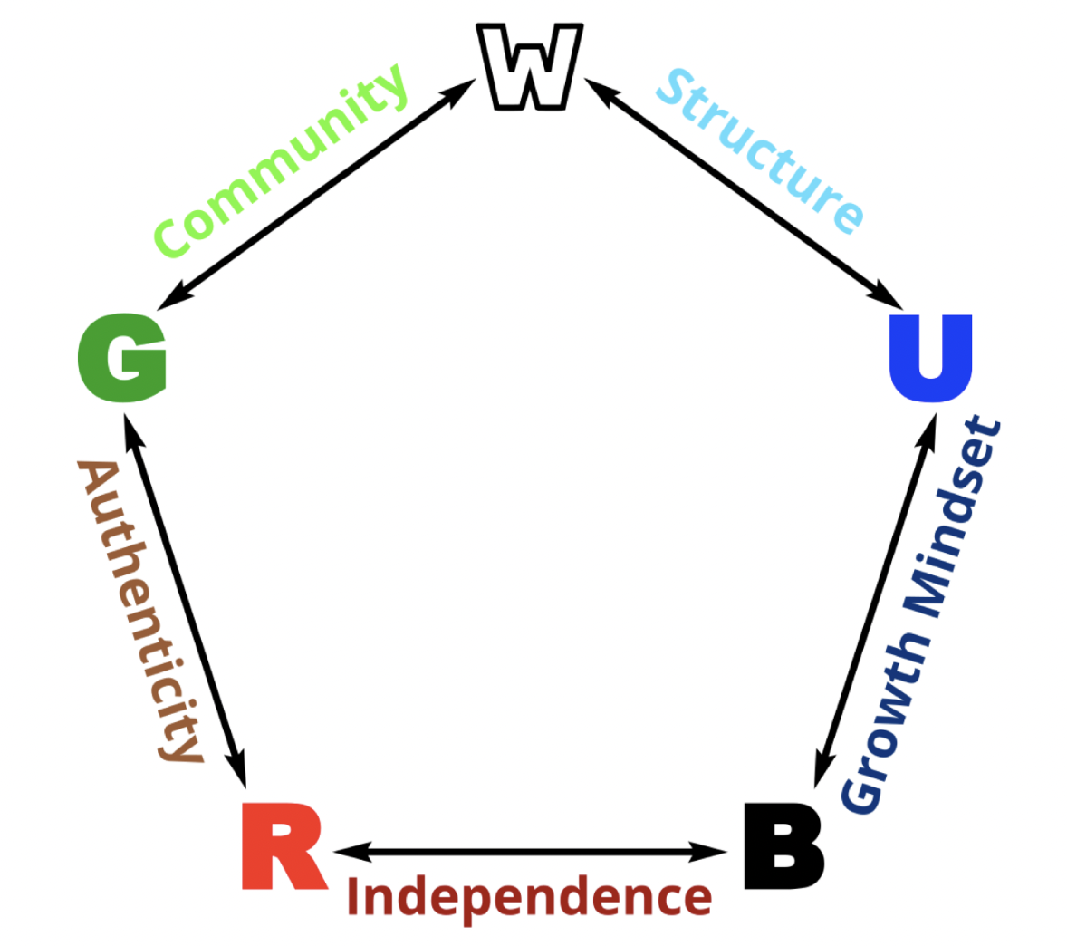
Analysis of Magic Cards
What Different Cards Disagree On
Magic is built upon two major concepts: The Mana System and the color wheel.
In the clustering graphs, there is symmetry that goes on in some graphs. This demonstrates the designer’s intentional balancing between the colors.
In the color wheel, according to Richard Garfield, each color has a central goal and default strategy, (W-peace, U-perfection, G-harmony, R-freedom, B-satisfaction)
In addition, the five colors disagree with one another in different ways. There are five central conflicts between the colors on opposite sides of the wheel, comparing and contrasting with one another.
What Different Cards Agree On

Slide 7
The Data

Slide 8
What is our data, and what use is it?
The data acquired came from two sites; https://www.mtgtop 8.com/ and https://mtgjson.com/

Slide 9
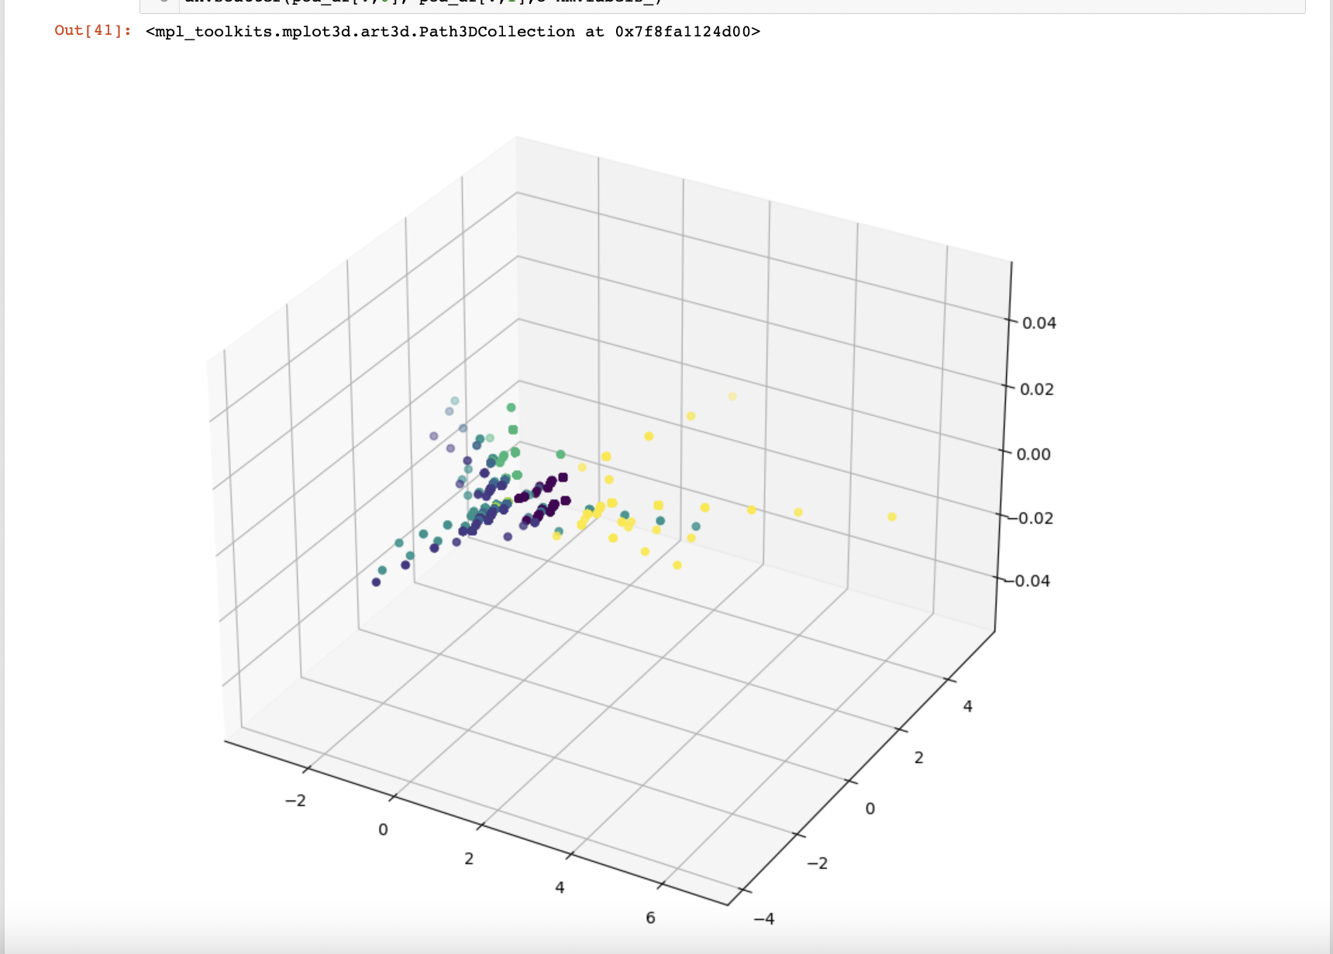
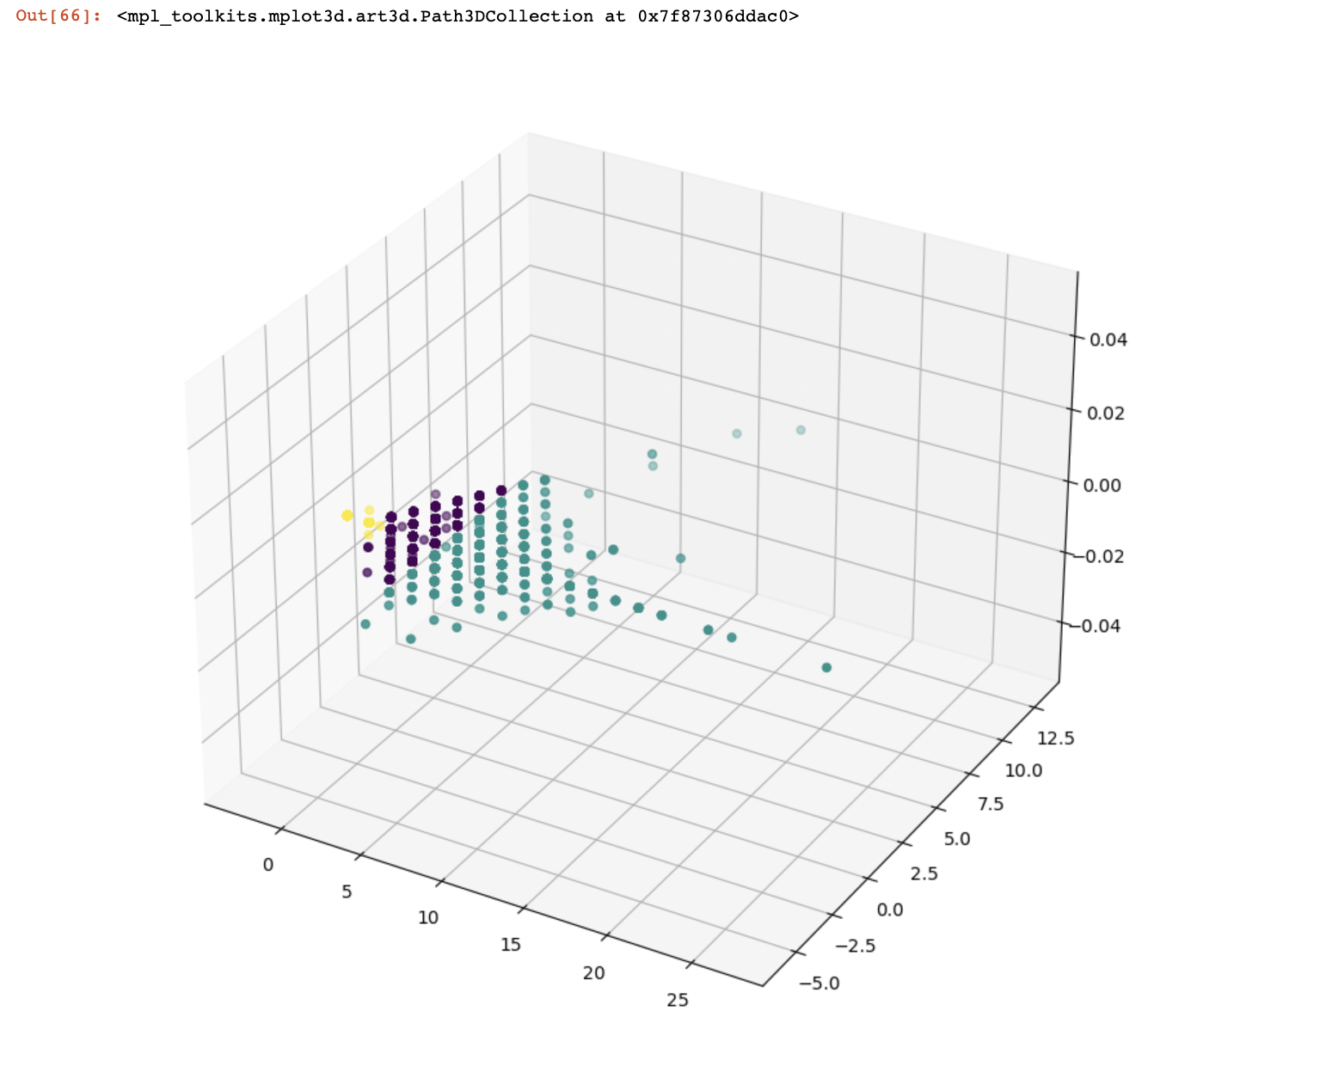
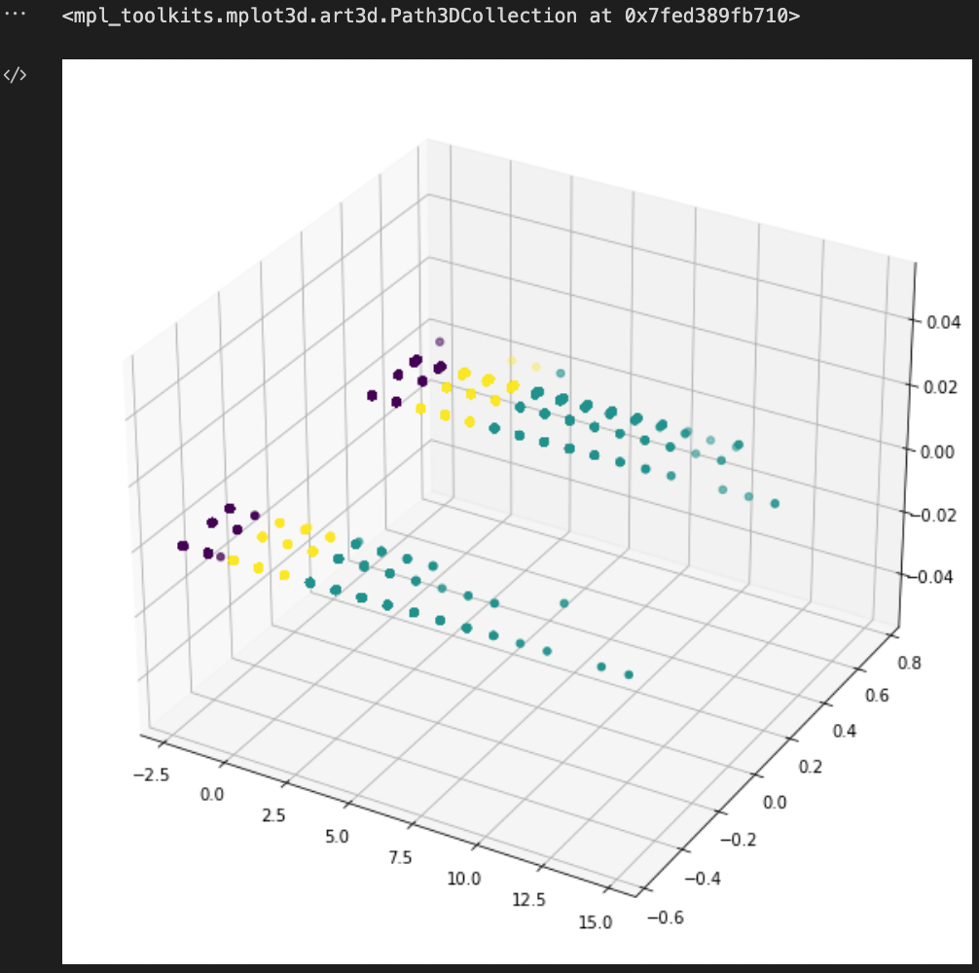
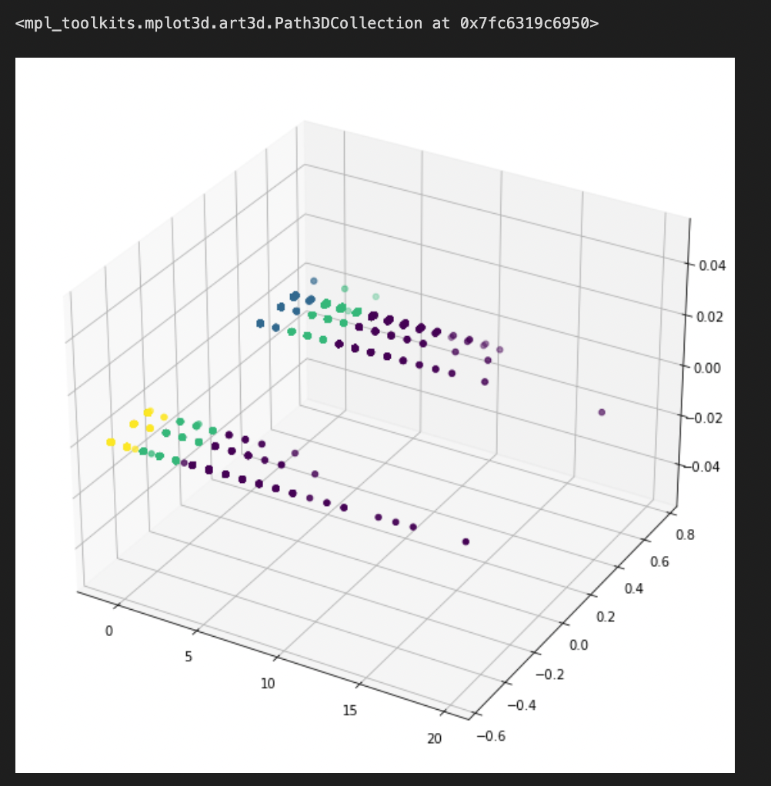
KMeans For Cards Manufactured
Creatures vs Toughness
Power and Toughness
Mana Value vs. Creatures
Mana Cost

Slide 10
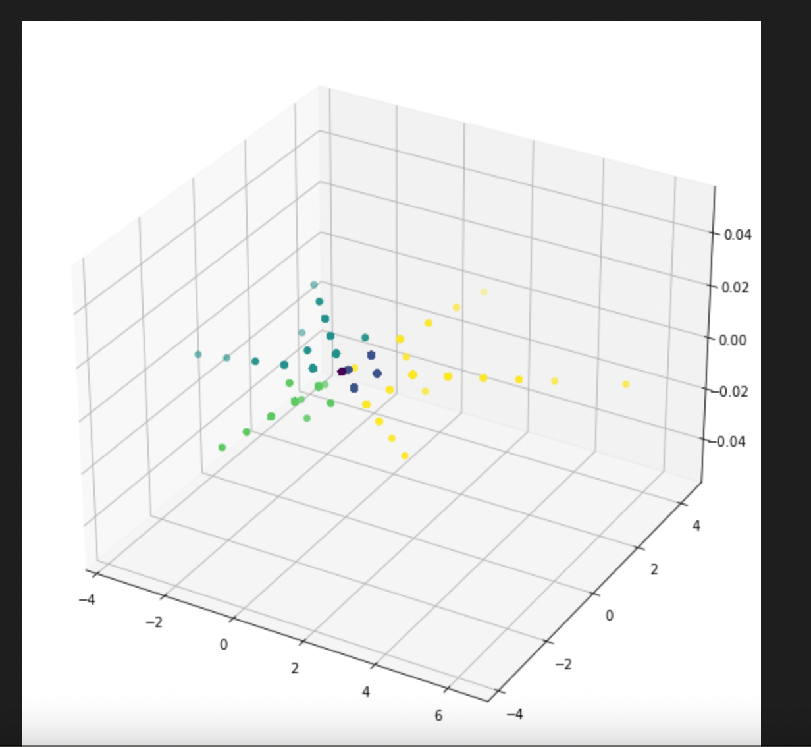
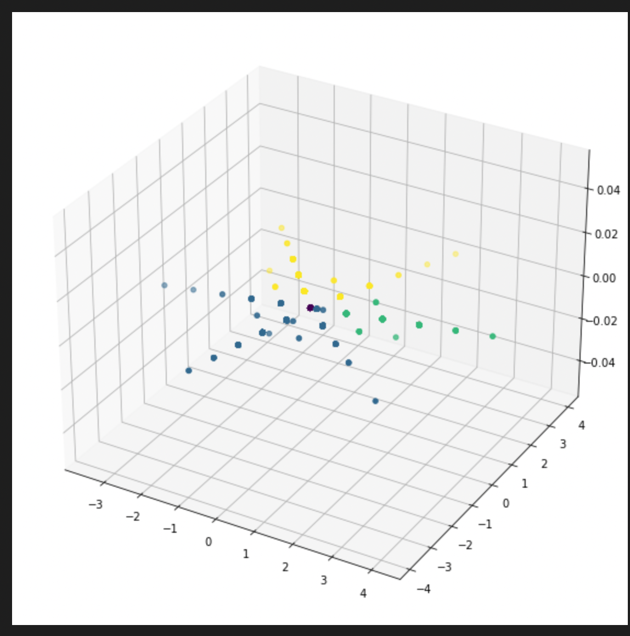
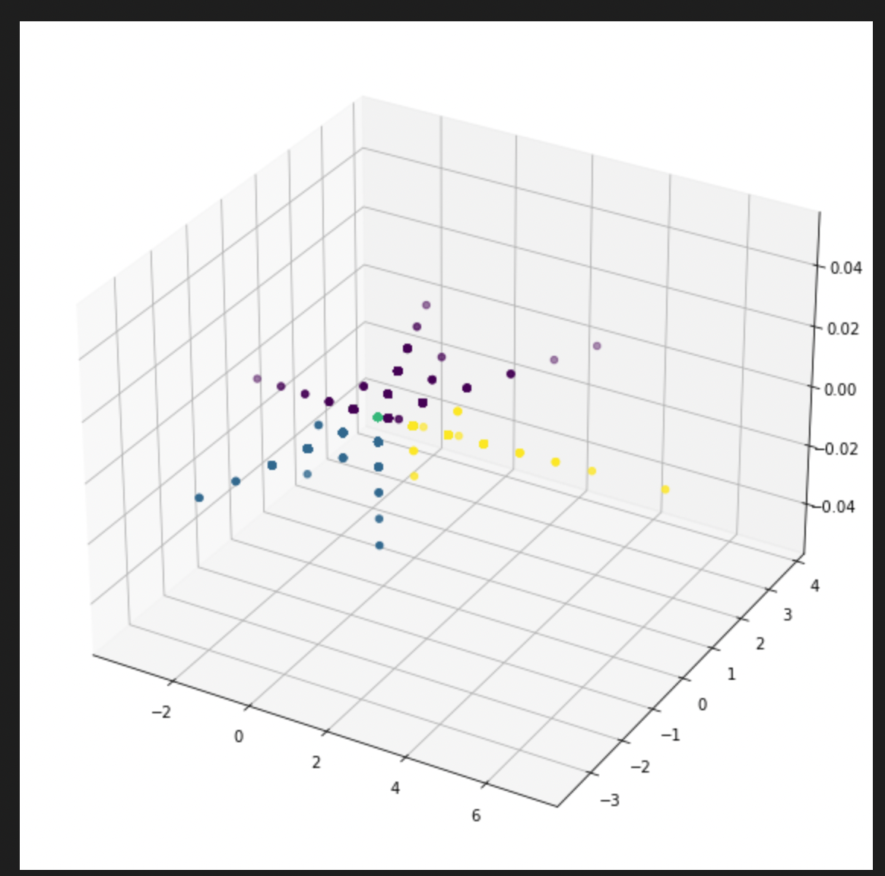
KMeans For Cards Manufactured
Mana Cost For Red, Green, and Blue Cards
Mana Cost For Blue, Black, and White Cards
Mana Cost For White, Red, and Green Cards

Slide 11
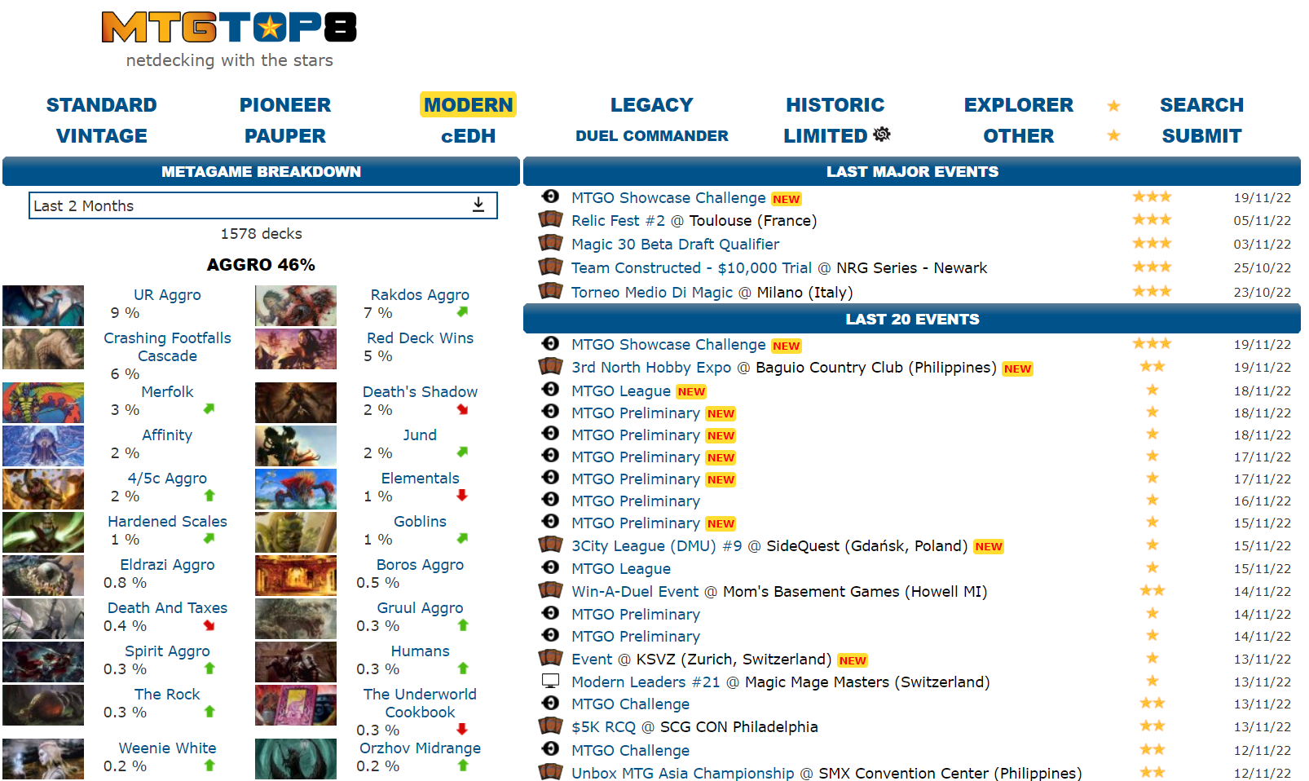

Slide 12
what’s a Format?
A format is a ruleset where a different subset of cards are legal to use. For our purposes we are looking at the most played competitive formats- Modern, Standard, Legacy, Vintage, Historic, Pauper and Pioneer.
Since each format is distinct, our tool needed to have the ability to select data from a given format without any noise from the others

Slide 15
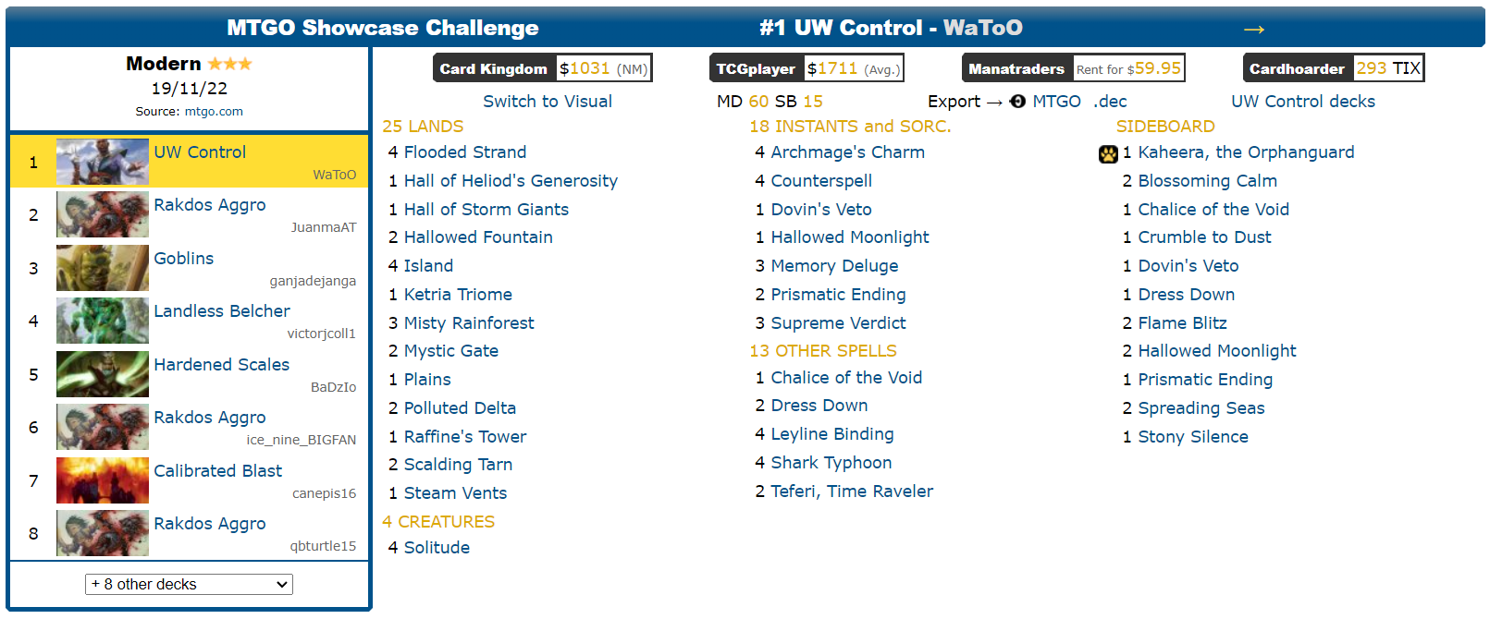
Tournament Info:

Slide 16
The Code

Slide 17
MTG Top 8 code
Scraping and assembling the data
This code scrapes the MTGtop8 website and creates a list of each decklist in a given format.
Cleaning and analyzing the data
Then we transform the data into a form that the machine learning algorithm can interpret and compare the decks to each other.

Slide 18
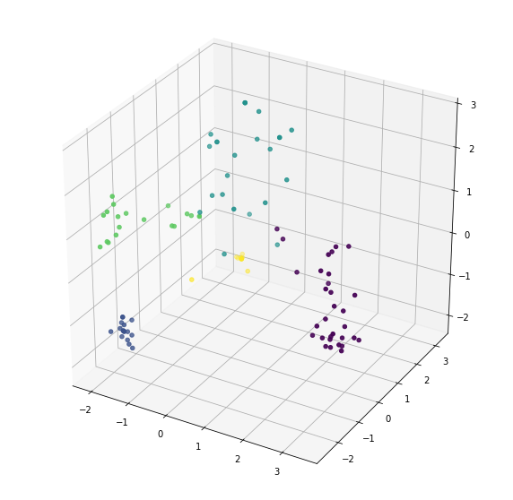
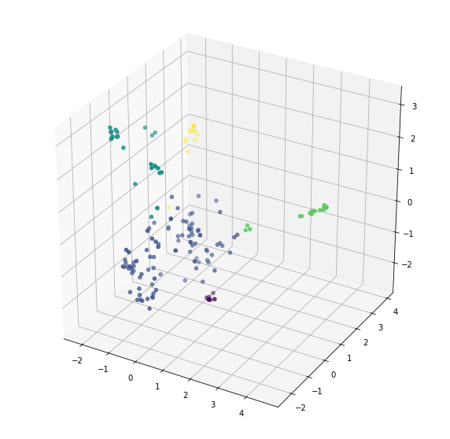
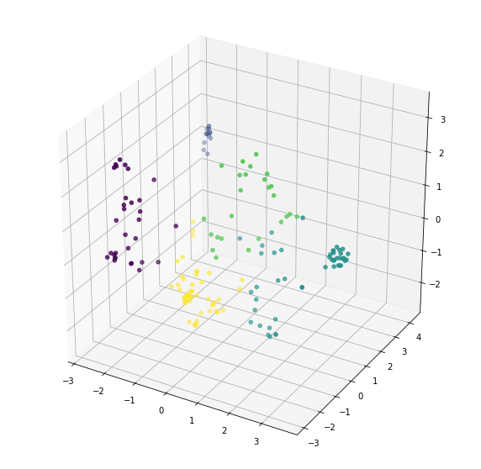
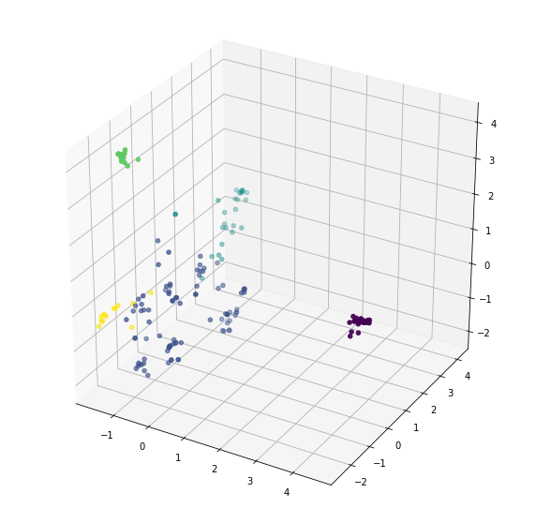
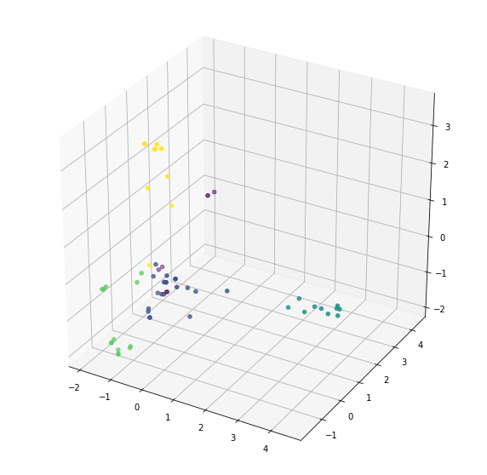
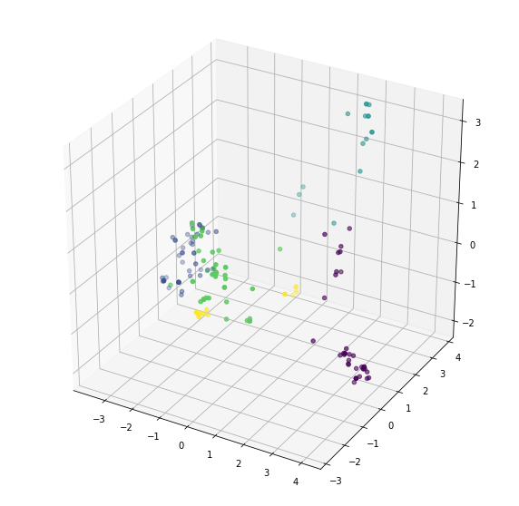
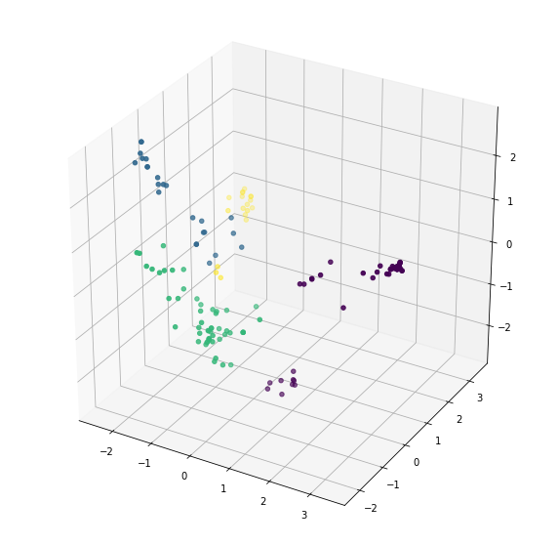
Standard
Modern
legacy
Pioneer
Vintage
historic
pauper

Slide 19
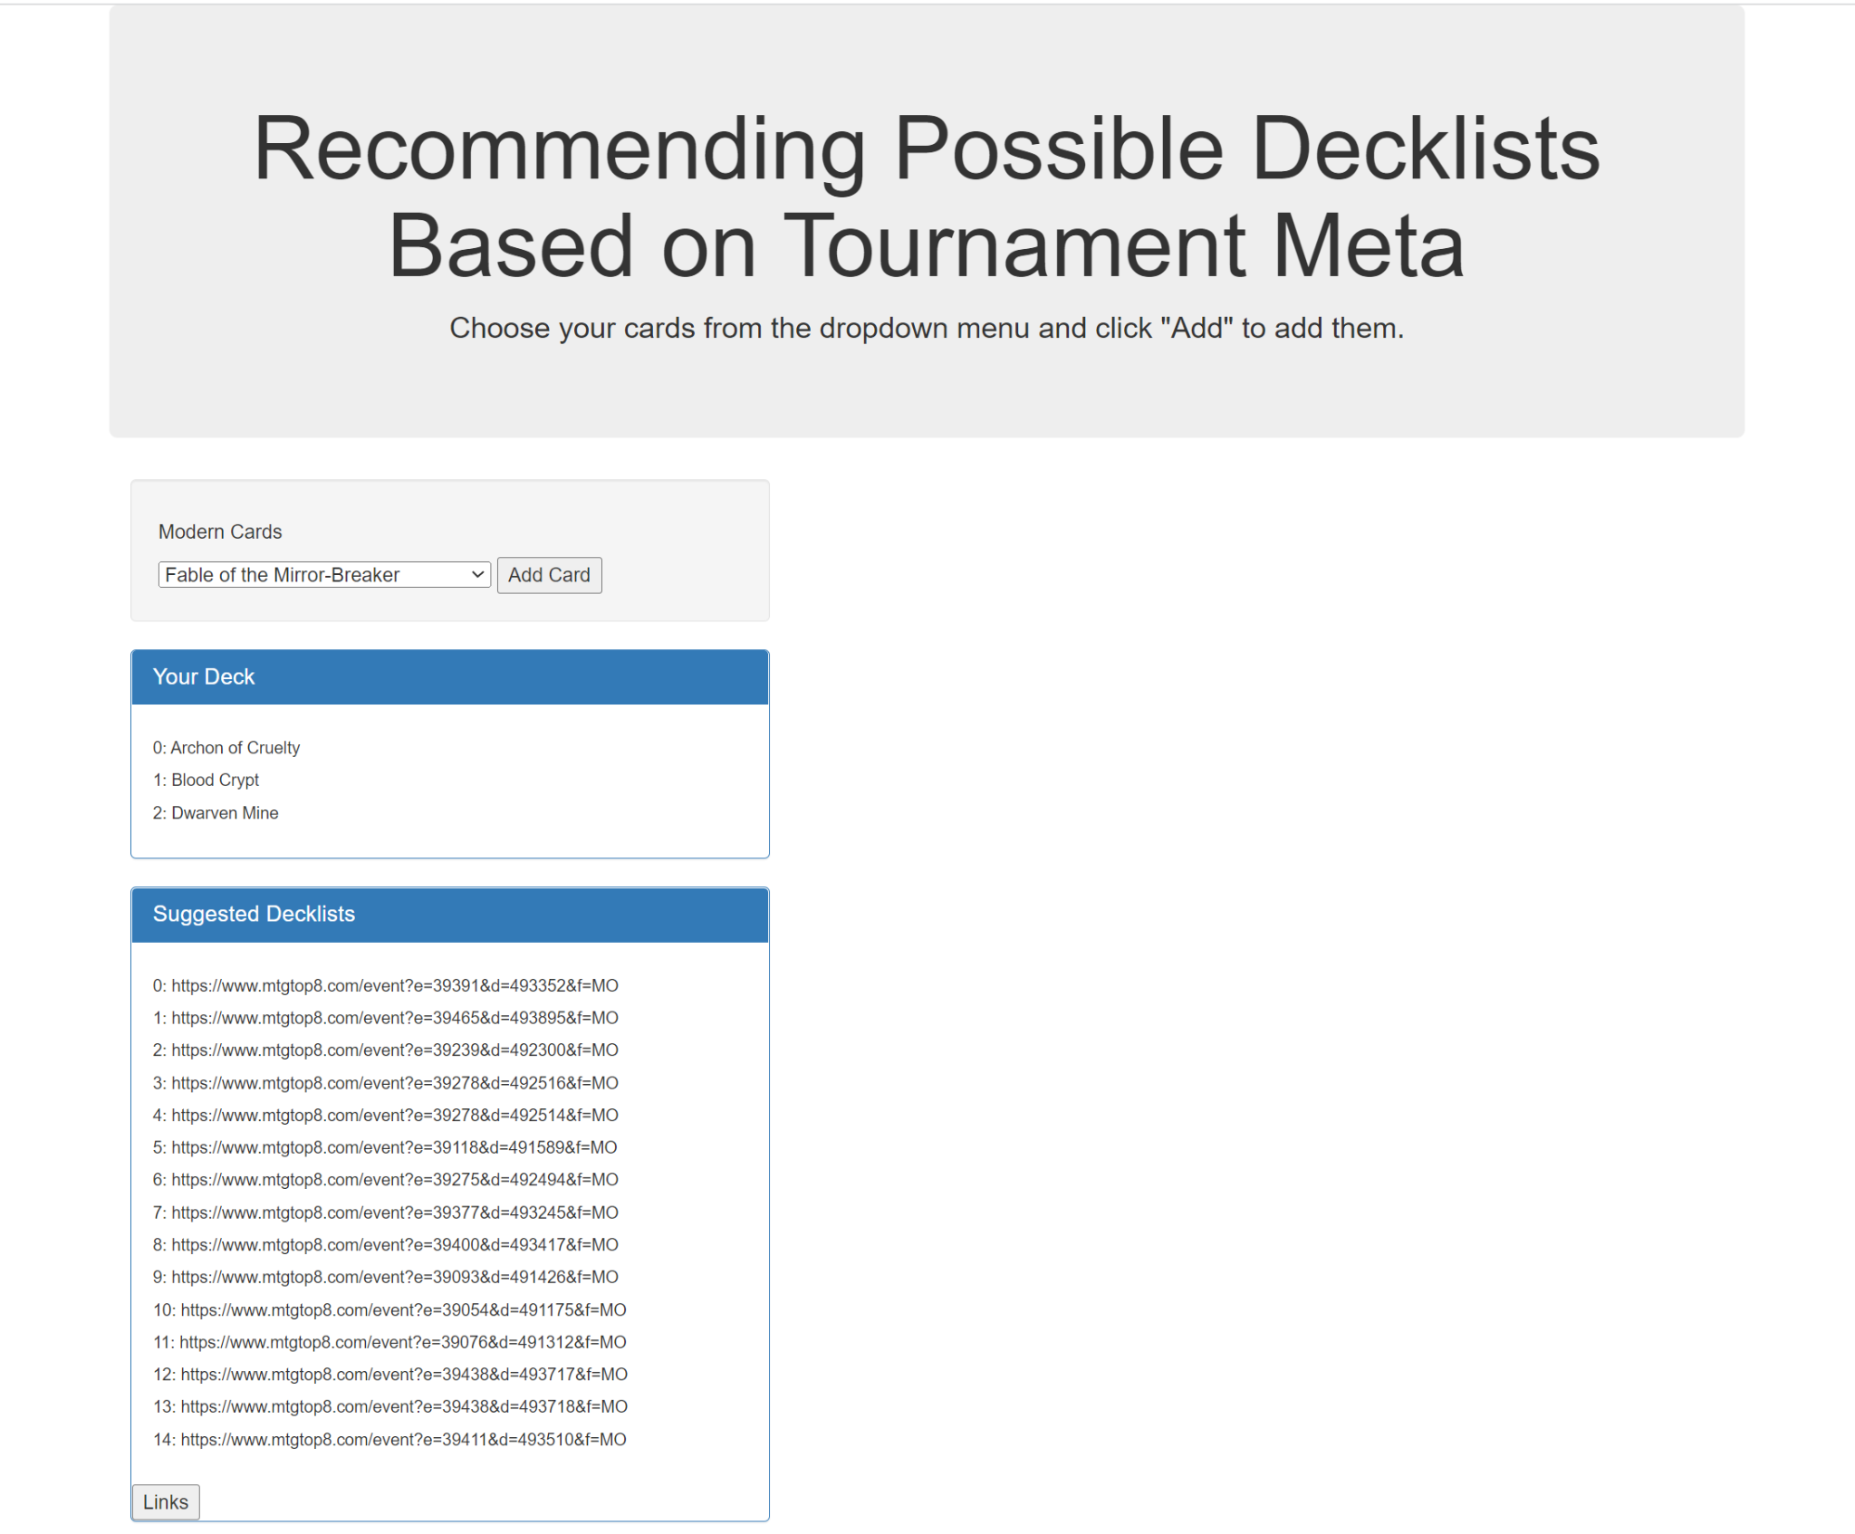
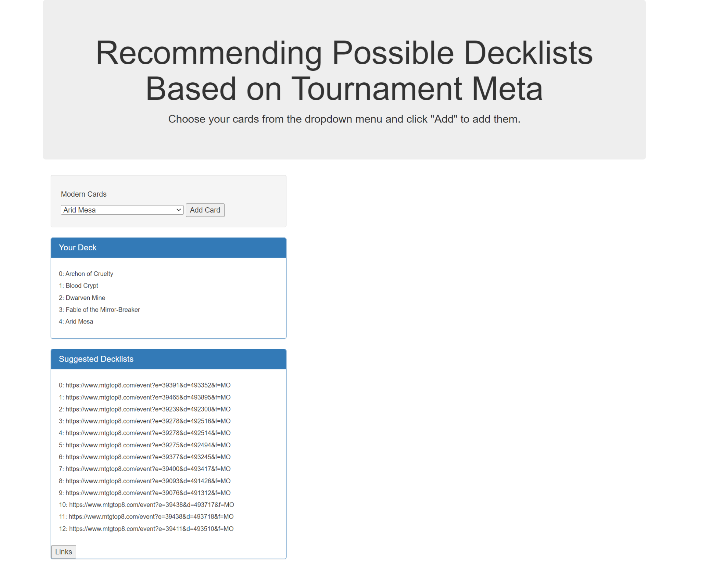
Interactive Display
Notes:
For interactive use of the data, we chose to use an HTML display with javascript functions. On this slide are screenshots, showing how the website would be used. Lists of cards from each format of Magic the Gathering were compiled into drop down menus. A user can find cards that they own or are currently using in their personal deck, add them to the list labeled “Your Deck” by clicking the “Add Card” button, and then click the “Links” button to display Suggested Decklists that include the added cards. The decklists are displayed as the links from our scraped data. As seen in the left picture, adding a few cards will populate several decks, while the right picture shows that this list of suggestions can be pared down by adding more cards to the “Your Deck” panel.

Slide 20
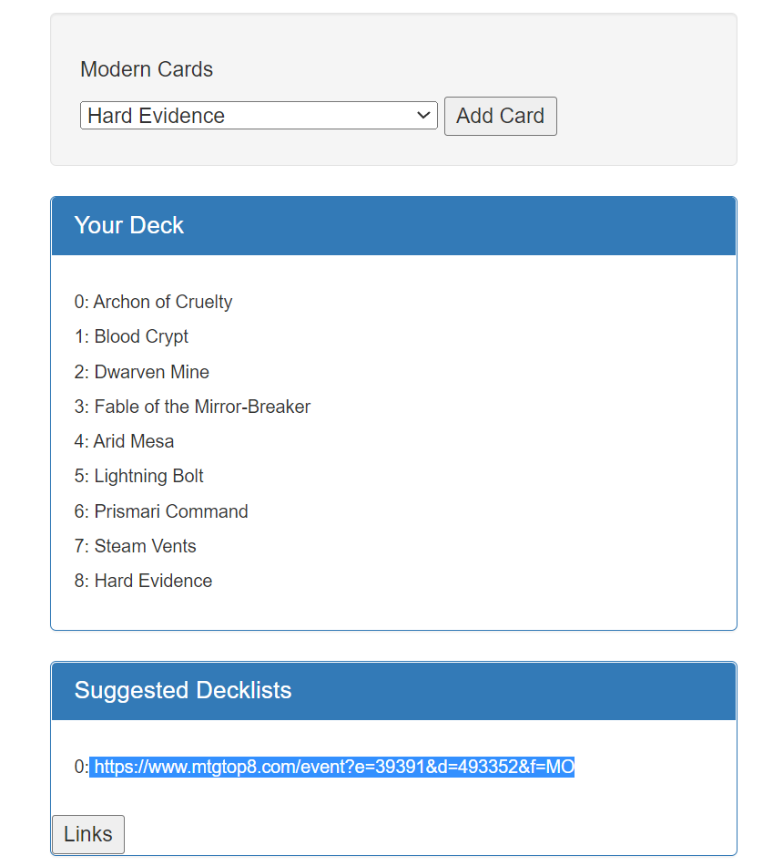
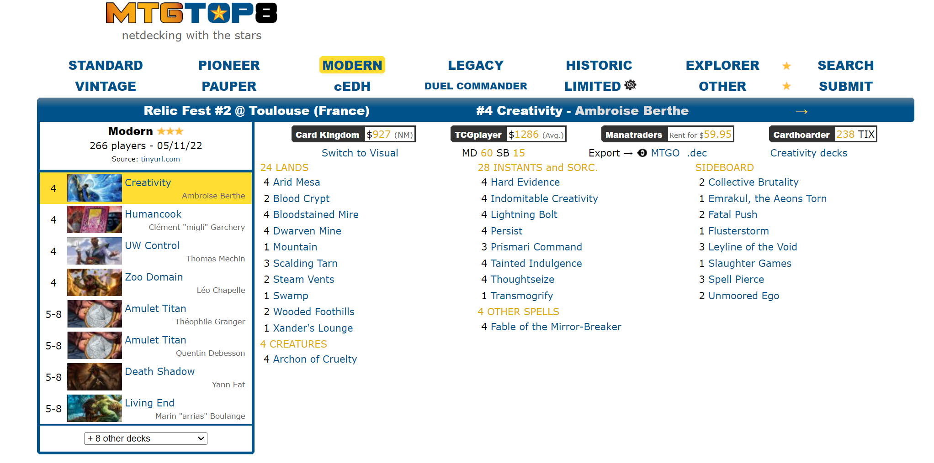
Interactive Display

